Slide 1
AlpACA, the Simple WAY -ALPCA RoR
Chris Alberts / Mark
DRAFT

Slide 2
What iS ALPACA
alpaca is an API (Application Programming Interface) to communicate with astro peripherals
the API is based on REST (REST-API)
a common method in IT to communicated between software applications on different platforms and or operating systems
it’s independent of operating system and hardware
it uses the network
ALPACA is not ASCOM, it makes use of the best practice’s and rules of ASCOM.
IT’s maintained by ascom developers and there for hosted on https://ascom-standards.org/ and based on that called it’s ASCOM-ALPACA
alpaca can be used by any astro software package on the market and is there for a game changer.

Slide 3

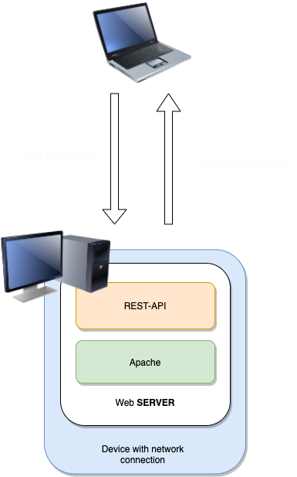
HOW WOrKS a (REST)-API
Client
REST-API is based on HTTP(S) requests and responses
It’s like finding something on the internet via the web browser
EXAMPLE SHOW HOW REST-API WORKS
you like to know where -29.2612,-70.7313 on this world is, you will ask google and use the internet browser in the client
type https//www.google.com (this specifies the google web server).
the coordinates are part of the google web application, maps
specify the maps web application in the request https://www.google.com/maps
to display coordinates on the map type the following request (URL) in de browser https://www.google.com/maps/@-29.2612,-70.7313,14z
the response is the location on maps, do you know where this location is?
with rest-api you can use methodes to instruct the web server what to do. In above example it was a “GET” request, only in the web browser the “GET” is used in de backround
other methodes are “POST”,“PUT”,”DELETE”. used in alpaca are the “GET” and “PUT”

Slide 4
REST-API Principle Plotted to ALPACA
Is the TELESCOPE tracking? the follow get request is defined with alpaca
get http://192.168.1.11:11111/api/v1/telescope/0/tracking
http://192.168.1.11:11111/ # this is network address van de driver (WEB Server) and port van de driver
api/v1/ # the version of api used
telescope/ # driver general function, like maps in the google example
0 # device number 0
tracking # a telescope action
with “GET” we get the status back of tracking. when adding the URL (Request ) in the browser the response looks like a json format in this it shows “value = true” tracking is on (see picture)
when using ”PUT” in de front of the same request tracking can be enabled or disabled
we call this ALPACA API CALLS and can be used when building software drivers
https://ascom-standards.org/api/#/ #overview of all ALPACA API calls

Slide 5
What is ALPACA DEVICE DRIVER?
it’s a web server with rest-api and network connection
lissening to the network, for clients to used the driver
can have one ore more functios (dome, telescope, Focusser…….)
like maps in the google example
it will response on “put” or “get” requests from clients who will us the driver
clients could be observatorium control systems (OCS) or software like apc / sgpro / cdc (if they support today alpaca depends on the aplication builders)

Slide 6
What is ASCOM-REMOTE for Windows
ascom-remote = alpaca device driver / alpaca web server
it’s software for windows
it makes communication possible with conventional ascom drivers via the netwerk
ascom-remote acts on rest-api calls as definde https://ascom-standards.org/api/#/ #Overview of all alpaca api calls
a way to give other platforms access to windows connected ascom drivers connected to astro peripherals

Slide 7
DeFINE NEW ALPACA DEVICE Drivers in Windows / ALPACA Discovery
Choose =>Tools =Setup
this is not related to ascom-remote !!!!!
a new alpaca device can be discovered on the network
the client initiats a broacast on the network and all listing device drivers will answer
in the information exchange all needed get and put info is shared with the client
the client create automaticly an alpaca device driver (New alpaca device..)
defining alpaca devices is hidden deep in the ascom software, find the ascom chooser there is no icon, hint use the device hub even when you not use it.
In the chooser there is alpaca menu to manage the alpaca devices

Slide 8
EXAMPLE 1: ALPACA – Roll oFF ROOF (ROR) Driver on Raspberry PI
Device hub ascom
used for ror based observatories on open and close switchs or a pulse when garage door opener is used . the rol movement is stop by using two limit switches, (FUNCTION SHOUD BE ADD. BASED ON GPIO LOW ROLL STOPS)
base on raspbarry PI with relaisschild (link)
relais are connected in parallel with the open and close switch ROR
https://github.com/msproul/AlpacaPi (see readme.md for installation instuction)
using the device hub, the driver by discovered and configured

Slide 9
EXAMPLE 2: Park and CLOSE obserVATORY
initiated park of telescope via ascom-remote to conventional ascom driver
writer use a raspberry (node-red) as OCS, based on watchdogs
power down, internet outage, rain, wind can initiated close roof and park telescope
the following put calls are used
put https://192.168.1.11:11111 /api/v1/telescope/0/park
put https://192.168.1.11:1111/api/v1/dome/0/closeshutter
and with the get request the status of the ascom drivers can be collected

